Slide 1

CQRS & Event sourcing
Ein Schnellkurs

Slide 2
Referent – Sia Ghassemi
Founder of Sia Consulting
Cloud-Consulting
Cloud-Development
Cloud-Security
Domain Modeling / Domain Driven Design
Trainings
GPT Consulting & Development

Slide 3
Agenda
History of CQRS
CQRS – What it is
History of Event Sourcing
Event Sourcing – What it is
Famous examples of Event Sourcing & CQRS in modern Applications
CQRS with Event Sourcing – The allmighty combination

Slide 4
History of CQRS
First described 1988 by Bertrand Meyer as CQS
Picked up by Martin Fowler 2005
Picked up by Greg Young 2008 -> CQRS 2009

Slide 5
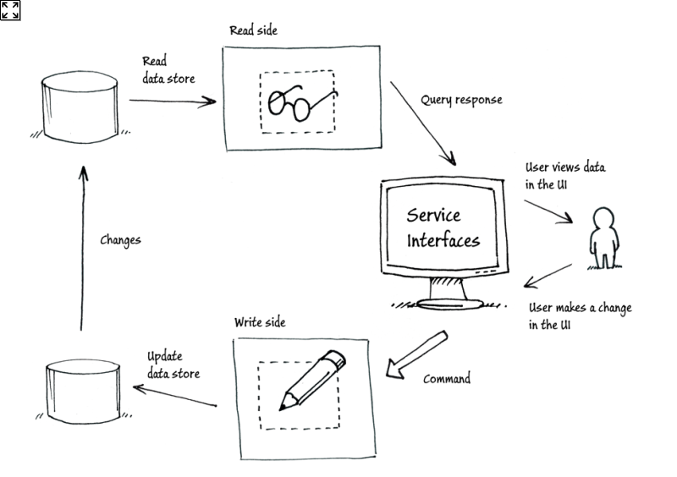
CQRS – What it is
Asking a question should not change the answer – Bertrand Meyer 1988

Slide 6
CQRS – What it IS
Benefits
Clear segregation of responsibilities
Side effect free queries
Mutations do not return data
Challenges
Async
Eventual consistency
Rethinking of data operations

Slide 7
History of Event Sourcing
First work chain of blocks described 1991 by Stuart Haber and W. Scott Stornetta
Described as EventSourcing 2005 by Martin Fowler
Blockchain – 2008 by Satoshi Nakamoto

Slide 8
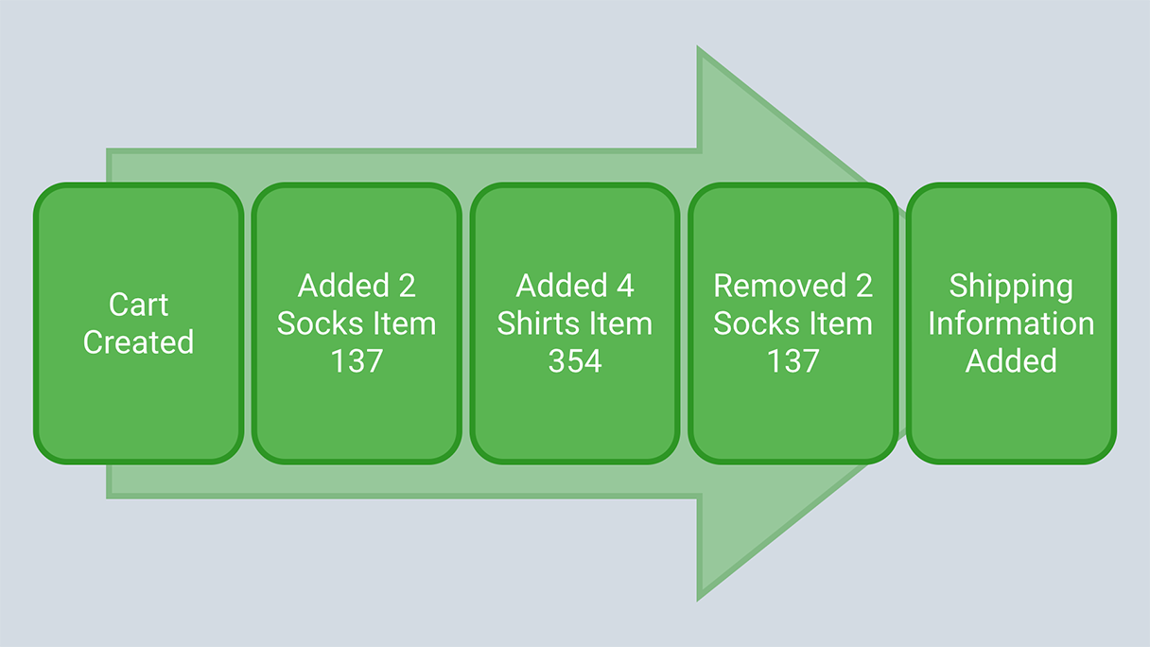
Event Sourcing – What it is
Capture all changes to an application state as a sequence of events. – Martin Fowler 2005

Slide 9
Event Sourcing – What it is
Can be used with any Database/Storage
SQL
NoSQL
Instead of saving State, save changes
Append only
State is generated from Replaying all Events in order (Hydration)
No entities – just events
Real world way of creating state
Non Blocking, async, event based

Slide 10
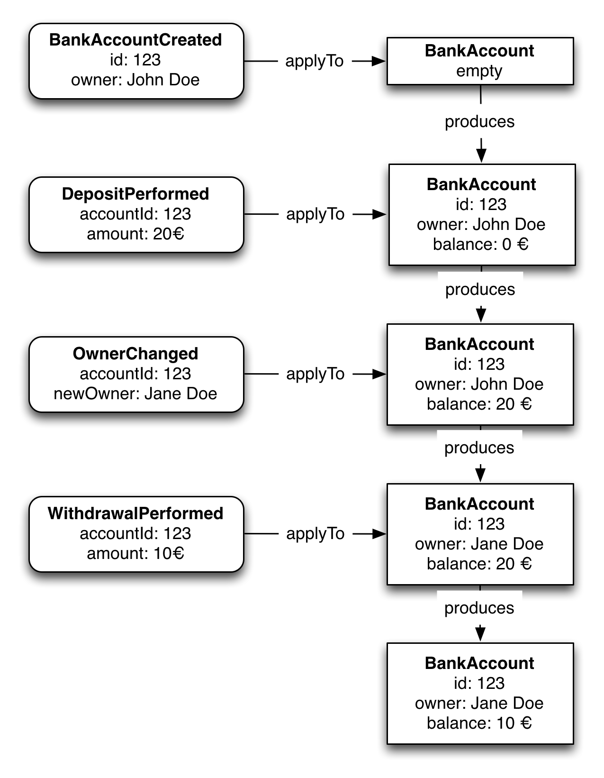
Event Sourcing – What it is

Slide 11
Famous examples of Event Sourcing and cqrs
Event Sourcing
Blockchain
Git
CQRS
Redux
Flux

Slide 12
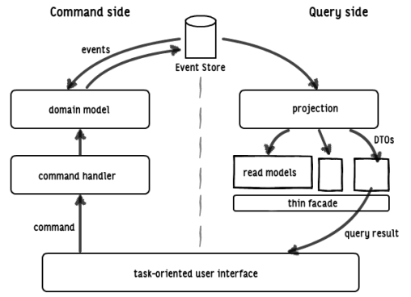
CQRS with Event Sourcing – The allmighty combination

Slide 13
Thanks
Questions?

